Slide 1


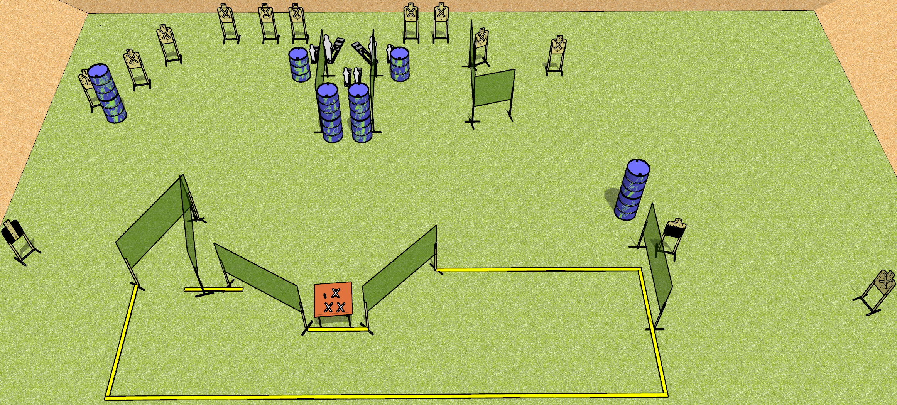
 | Dothan Gun Club – USPSA Match Shooting Around Course Designer : Drew Coleman
START POSITION : Standing with both hands flat on marks
GUN READY CONDITION : Firearm unloaded with trigger guard on mark. First magazine placed anywhere on barrel/table |  | SCORING: Comstock, 32 rounds TARGETS: 13 paper, 6 Steel SCORED HITS: Best 2 on paper, steel until down START-STOP: Audible, last shot RULES: First magazine must come from barrel/table
STAGE PROCEDURE: Engage targets as they become available from within the fault lines

